Slide 1
GIT & Collaborative coding

Slide 2

Collaborative coding
What is Collaborative coding?
Collaborative coding is a method in which multiple programmers work simultaneously on a code project.
This helps with efficiency and quality of code, as you are constantly reviewing the code.
It also helps you with knowledge sharing among the team.

Slide 3

Introduction on GIT
What is GIT?
Git is a control system that tracks versions of files.
It is used to control source code by programmers collaboratively developing software.
Git allows you to edit your code and take snapshots during your coding journey.

Slide 4
How to install GIT on your computer
01

Slide 5
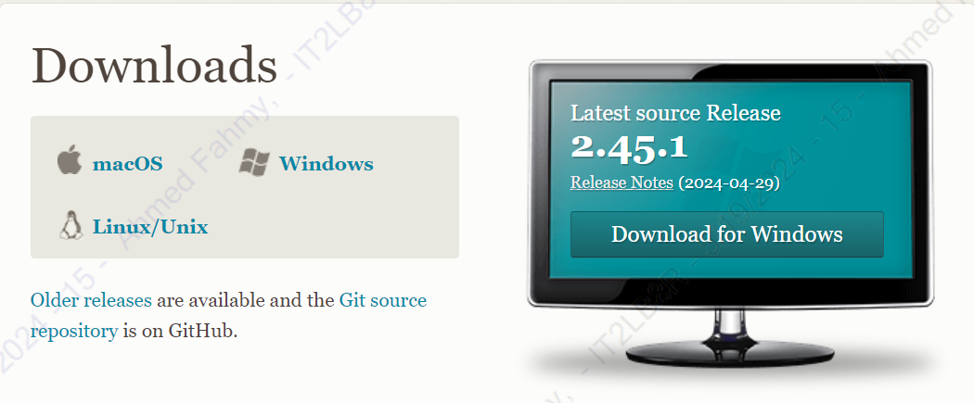
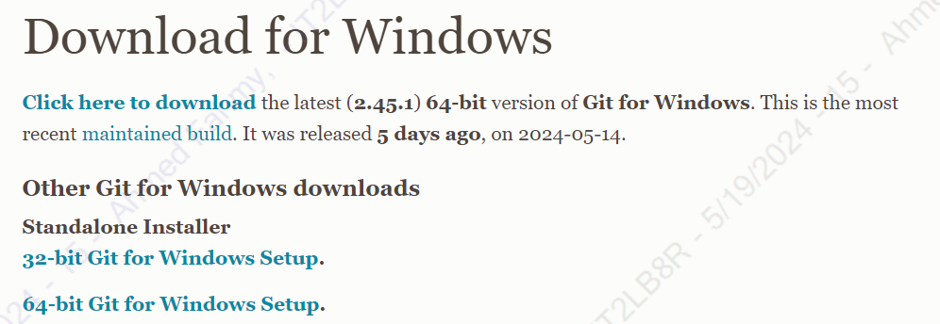
GIT installation
Since we are on windows, we will go to https://git-scm.com/downloads and click on windows. Click on which version of windows you’re running and wait until it’s downloaded then run the program and leave every choice as it is and keep clicking continue.

Slide 6
Adding GIT to a project
02

Slide 7
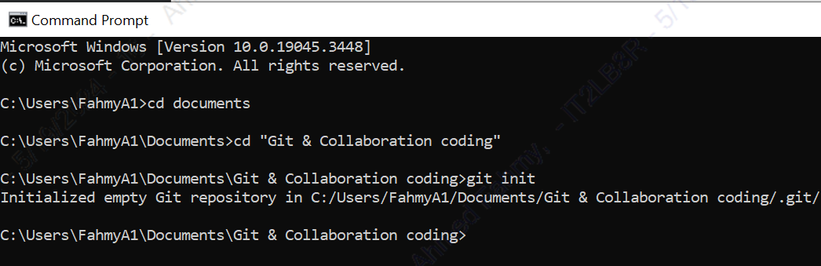
Adding GIT to Projects
You’ll need to open command prompt and type the following command: cd <add the directory of the folder where the project is located> note: “cd every folder until it leads to the destination”
After CDing to your destination, type: “git init” and press enter, and this will create the Git repository.
Last step, you need to type:
git config --global user.name "John Doe" git config --global user.email johndoe@example.com
Replace the name and email with your name and email as this will be your identity when you change something
Lastly, you’ll need to type “git add –A” this adds all the content into a staged environment, to make it committed type “ git commit –m ”<add the name of the commit there>” “

Slide 8
How to use GIT
03

Slide 9
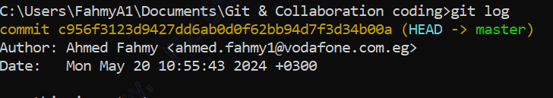
How to use GIT
After you successfully added GIT to your repository, you can now fully utilize GIT.
If you want to check if there is any modifications to the code/file, type: “git status” and it will show you all the modified files if any were.
If you want to go back to a previous version of the code, you type: “git log” and you’ll find all the commits you made, copy the commit key of the commit you want to go back to and type: “git checkout <paste the commit key you copied>”

Slide 10
Setting up GitHub
04

Slide 11

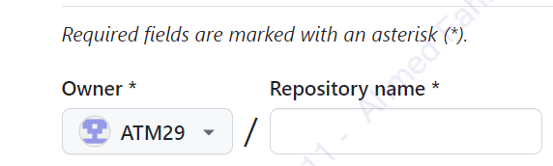
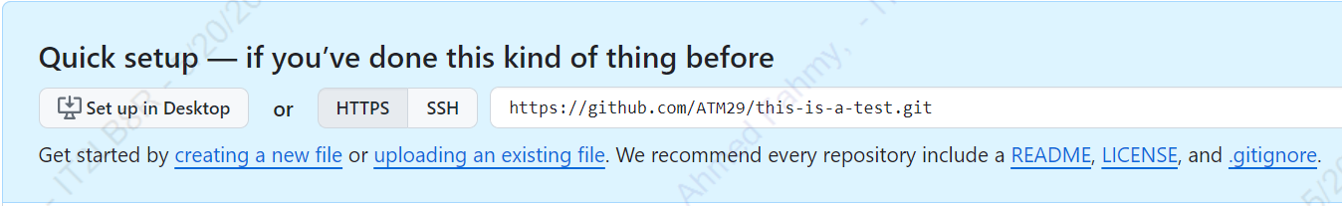

Setting up GitHub
To track any changes done by the team, you need to go to https://github.com/ and sign up to an account if you haven’t
Once you create one and sign in, click on the plus sign on the top right, then a new page will appear, you’ll find “Repository name” add a name to the repository the at the bottom click “Click Repository”
After that, you’ll find in the middle the option “Set up on Desktop”, click download and run the app after it’s installed.
After it’s installed successfully, sign in with your account.

Slide 12
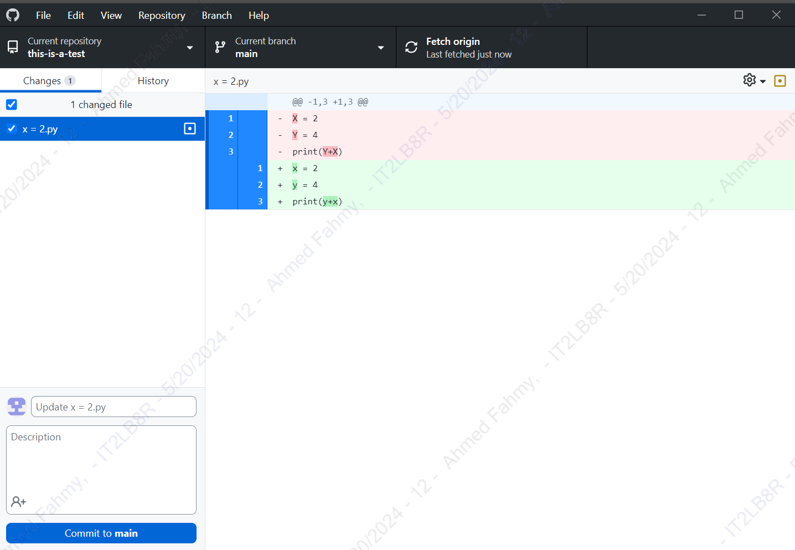
Setting up GitHub
After you sign in, this is the window that will appear, here you’ll find all the repositories, changes, branches, and any history about the code.
Any code that has been changed automatically will appear here with the change that happened.
If you want to branch away and do something standalone, click “current branch” then “New branch” then name the branch and click “Create Branch”.
If you want to commit instead of using CMD, use the “Commit to Main” button on the bottom left corner of the app.

Slide 13
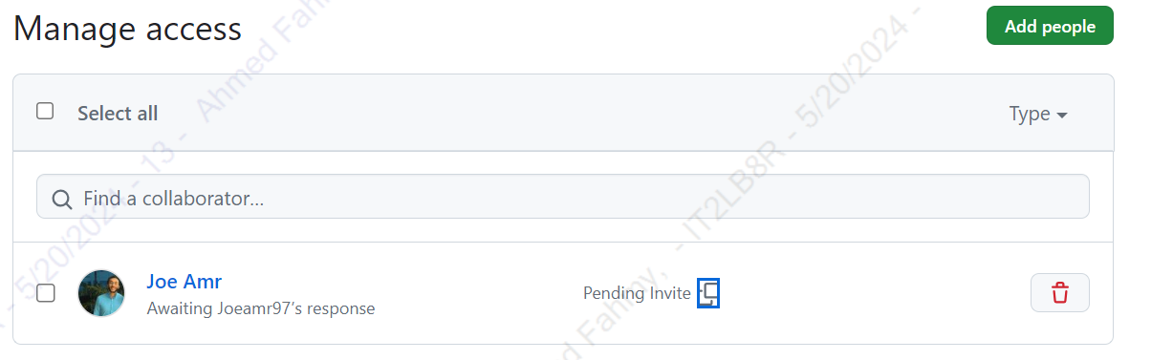
Setting up GitHub
Once you commit the code, the code will reflect upon all the contributors of the code and it will show you the change on GitHub app, as well as the IDE you’re using
To add a contributor, go to GitHub website and click “Settings” then on the left there is “Collaborators” click on it and in the middle, you’ll find “Manage Access” add all the users you want them to edit

Slide 14
Commands and their uses
05

Slide 15
Commands and their uses
Commit: Record changes to the repository.
Branch: List, create, or delete branches.
Push: Update remote refs along with associated objects.
Pull: Fetch from and integrate with another repository or a local branch.
Fetch: Download objects and refs from another repository.
Merge: Join two or more development histories together.
Diff: Show changes between commits, commit and working tree, etc.

Slide 16
Commands and their uses
Commit: To commit, click on the bottom left blue button
Branch: Click on the button on the top middle and click “New branch”
Push: To push, click Ctr+p or click on “Repository” then choose “Push”
Pull: click on “Repository” then choose “Pull”
Fetch: click on “Repository” then choose “Fetch”
Merge: click Current Branch. Click Choose a branch to merge into BRANCH

